Slide 1



Convertly
A Unit Converter
By: Regan, Siddharth
and Bryan

Slide 2

Introduction
01
A brief description of our project

Slide 3
But first,
picture this

Slide 4
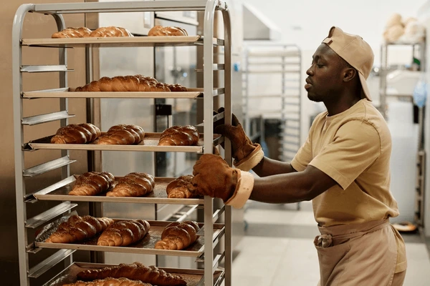
Meet Jason
He is a baker and often follows his grandmother’s recipes to bake goods

Slide 5

Jason faces a problem
When he follows the recipes to bake his goods, the units are often confusing and hard to follow
This affects his baking as he has to spend time searching to convert the recipe into his needed unit

Slide 6
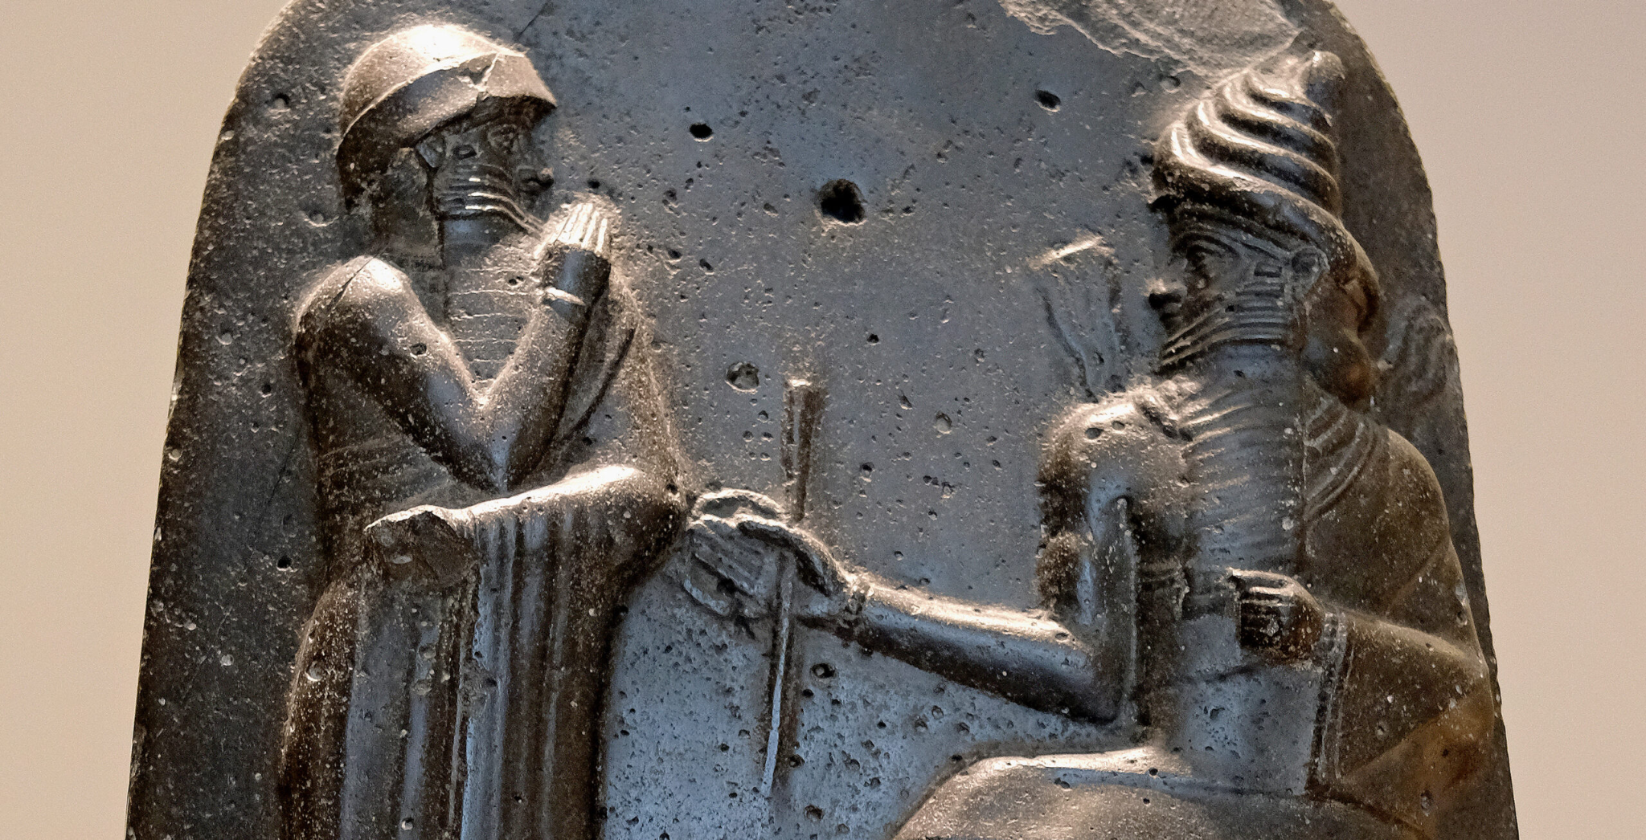

What is a Unit?
The unit was first used in 4th and 3rd millennia BC.
Ancient Babylonians, measured length using body parts, time by celestial movements, and volume by counting seeds in containers.

Slide 7
How can we solve this?

Slide 8
Convertly
A Unit Converter
To help Jason with his recipes

Slide 9
Brief description
Unit converter is a web-based tool
Does quick and accurate conversion of units across various categories
Used for cooking measurements, length, weight, temperature

Slide 10
Why did we choose a converter
When baking, Jason struggled to understand the recipe’s units (e.g. pounds, ounces, tablespoons)
Difficult to follow recipes
Makes it easier to convert units in recipes to measure ingredients

Slide 11
Prototype
02

Slide 12
Interesting features
Quiz
History Tab
Move convenient for Jason to see their converted units in the past
Gamified our website so users can have fun

Slide 13
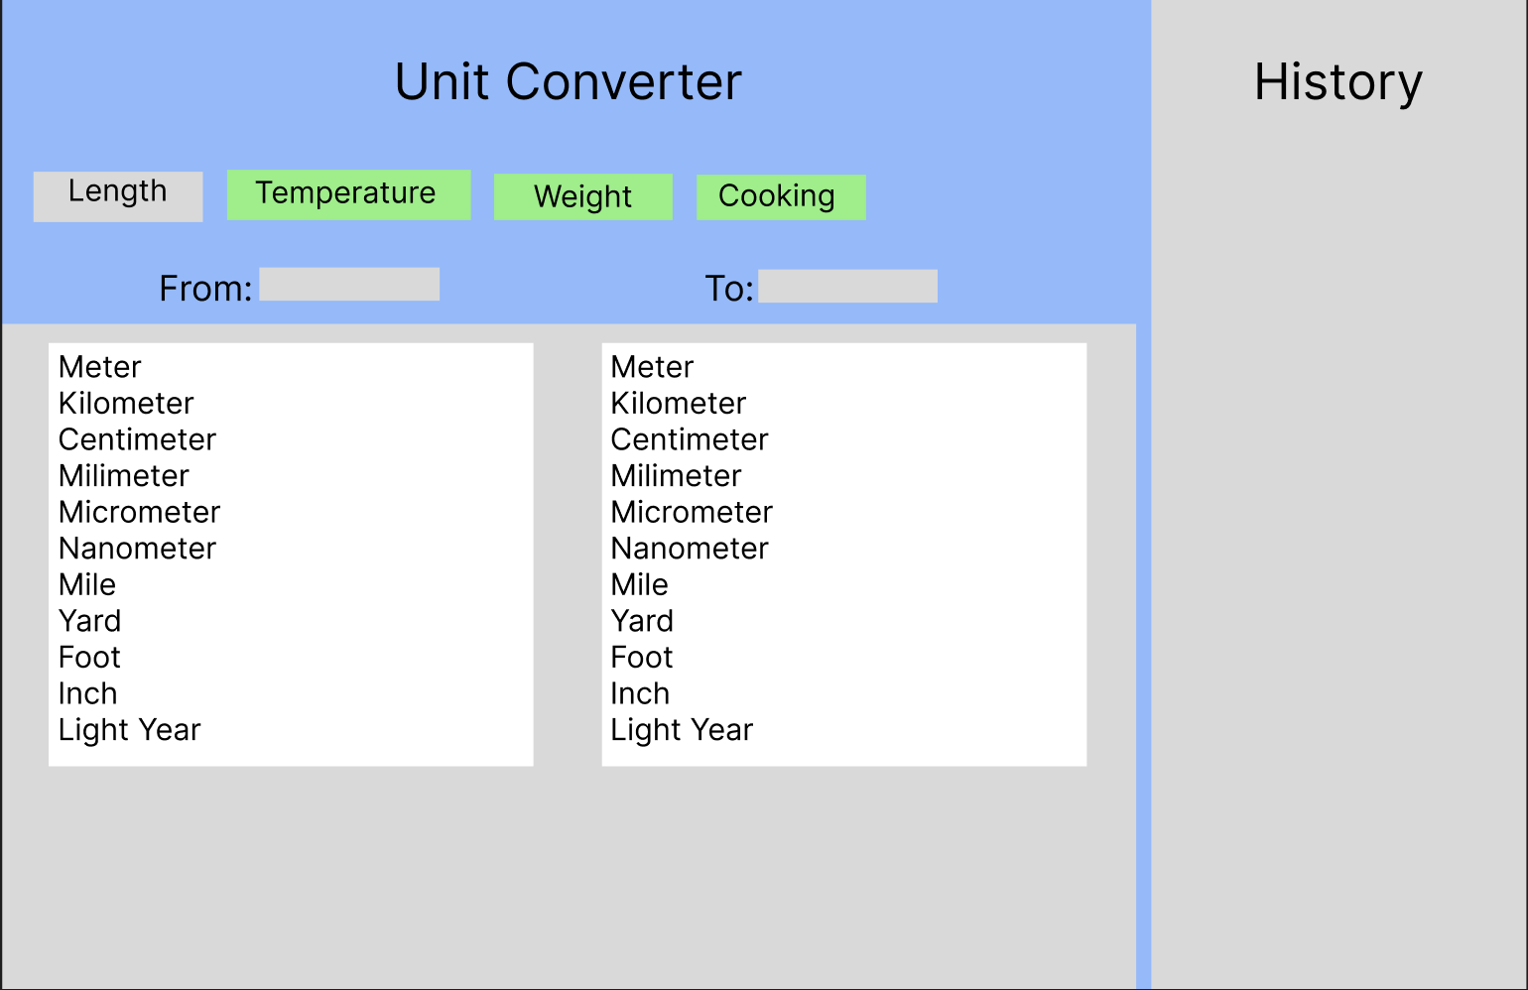

Slide 14
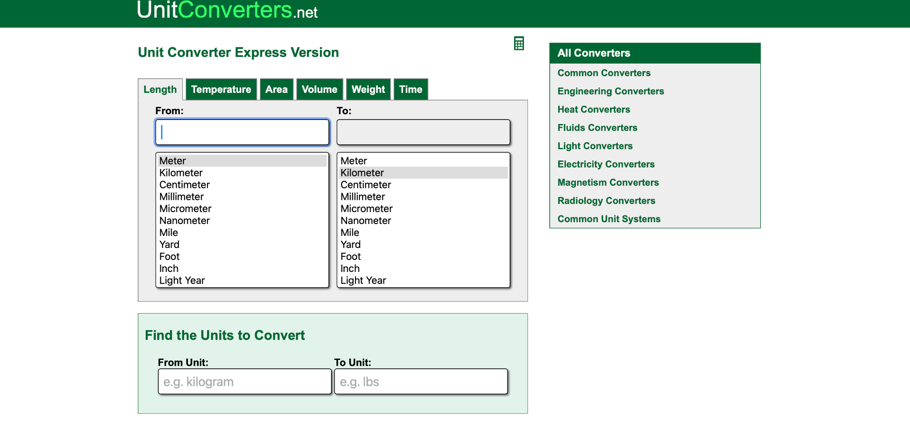
Inspiration
unitconverters.net

Slide 15
Our Website
03

Slide 16
Our Website
https://unitconverterdmn.w3spaces.com

Slide 17
Reflections
04

Slide 18
Future updates
Search Bar
More units
Custom
UI
Type in the search bar the units you want to convert
Wider range of unit (e.g. feet, inches)
Let user select the background colour and customise fonts

Slide 19
Problems Faced
There were times where some of us were absent
We had to juggle project work with school work
Bugs in code that affected progress
Communication skills
Time Management
Resilience
Notes:
We updated teammates with what we did the previous session, We planned out what we wanted to do each session, We did not give up and worked tirelessly to resolve them

Slide 20
Reflection
We learnt a lot different coding functions to help us in creating our own digital portfolio
We had many setbacks but still persevered
Teamwork makes the dream work

Slide 21
Thank You

